Slide 1
Weekly report: Feedback & Lidar – Assisted Controller
Week number: 12
Date: 16/12/2025
Supervisor: Prof. Dr.-Ing. David Schlipf
Group members: Mirza Dincer, Saurabh Pankaj Jha, Midhun Kanichattu Venu
Presenter: Mirza Dincer

Slide 2
List of Contents
Tasks of the week
AeroDyn Issues
Steady States of Optimus Syria
Step Response
Optimization Pitch Controller for Gain-schedule table
EOG simulation of Lidar-Assisted Controller
Mirza Dincer

Slide 3
Tasks of the Week
Adjusting controller
Calculating steady states for the Optimus Syria.
Check the step response behavior of the Optimus Syria for PI controller tuning.
Find an efficient values for gain-schedule table of pitch controller of Optimus Syria.
Check Lidar-Assisted Controller (LAC) with EOG simulation
Mirza Dincer

Slide 4
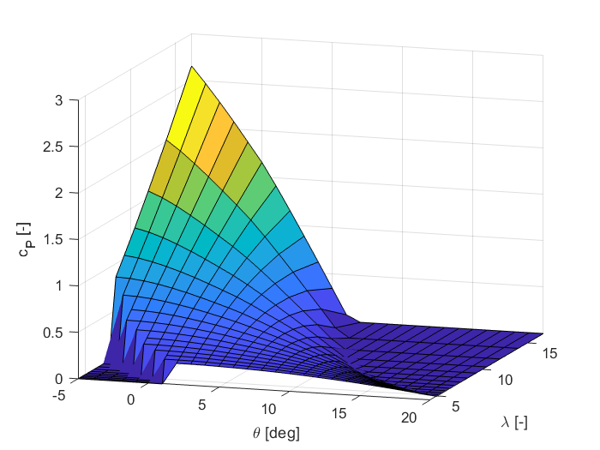
AeroDyn Issues
Original AeroDyn File had WakeMod = 0
0=none, 1=BEMT, 2=DBEMT, 3=OLAF
This caused from aerodynamic forces!
Now corrected to 1.
Please check files before you provide it
to other teams! Please be sure you know
your tools!
Mirza Dincer

Slide 5
AeroDyn Issues
Maximum power coefficient is now 0.43 at TSR = 9.7 and 0 deg.
Mirza Dincer

Slide 6
Simulation Settings for Steady States
600 seconds of simulation.
Wind speeds from 1 m/s to 30 m/s, with increments of 1 m/s.
Only enabled Rotor DOF and First fore-aft tower bending-mode DOF.
No initial conditions set.
Feedback controller adjusted for Optimus Syria.
Mirza Dincer

Slide 7
Rotor Speed
Mirza Dincer

Slide 8
Theta
Mirza Dincer

Slide 9
Generator Torque
Mirza Dincer

Slide 10
Tower Top Displacement
Mirza Dincer

Slide 11
Generator Power
Mirza Dincer

Slide 12
Torque Controller
Mirza Dincer

Slide 13
Step Response in Below Rated
In step response for below rated, we need a behavior of slightly damped (D = 0.7), and natural frequency of 2 -3 times slower than rated rotational speed.
For Optimus Syria rated rotational speed is 10 rpm = 1.047 rad/s
Mirza Dincer

Slide 14
Simulation Settings for Step Response
300 seconds of simulation, to see settled values for both wind speeds.
Step wind speed, from 6 m/s to 7 m/s.
Only enabled Rotor DOF and First fore-aft tower bending-mode DOF.
Initial conditions of rotor speed and fore-aft tower top displacement.
Feedback controller adjusted for Optimus Syria.
Mirza Dincer

Slide 15
Kp and Ki for Torque Controller
Starting Kp chosen same as IEA 3.4 MW,
Kp = 961 [Nm/(rad/s)].
Ki = Kp / Ti, where Ti = 6 s.
Check different Kp values for a behavior of
D = 0.7, and w = 0.4 - 0.5 [rad/s].
In the figure, we compare the step response of different Kp values from 6 m/s to 7 m/s.
It is seen that as we increase the Kp, we get a better behavior.
Mirza Dincer

Slide 16
Step Response Result of Kp = 1400 [Nm/(rad/s)]
Mirza Dincer

Slide 17
Optimization of Pitch Controller
Kp, Ki and theta is a vector with a 30 number of elements in ROSCO input file.
It is time consuming to calculate Kp and Ki for each theta angle. Instead, an optimization method is used.
Ti will be kept constant to 1P time.
Start by choosing a starting point of Kp and theta, and neighbor points. Then convert this points to a vector for ROSCO input file and run DLC 1.2 simulation.
As a result, We will have a map with each point we selected with DEL and AEP, will search for the point where minimum DEL of tower base fore-aft bending moment and the AEP is maximum.
Mirza Dincer

Slide 18

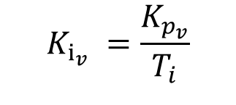
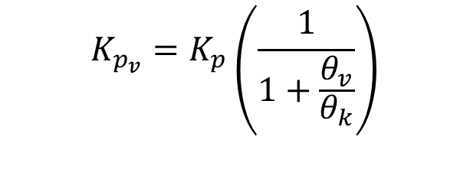

Optimization of Pitch Controller
$θ_{v}$, $T_{i}$
$$K_{p_{v}}=K_{p}\left(\frac{1}{1+\frac{θ_{v}}{θ_{k}}}\right)$$
$K_{p}$, $θ_{k}$
Mapping
$$K_{i_{v}} =\frac{K_{p_{v}}}{T_{i}}$$
Mirza Dincer

Slide 19
Simulation Settings for Optimization
660 seconds of simulation. Evaluation of values starts at t = 60 second to get settled values. Additionally, wind wraps around.
DLC 1.2 wind fields with average of 8 m/s to 24 m/s with steps with 4m/s, 3 seeds.
Enabled all DOFs.
Initial conditions of pitch angle, rotor speed and fore-aft tower position for every corresponding wind speed.
Running only feedback controller, no Lidar-assisted controller.
Mirza Dincer

Slide 20
Optimization of Pitch Controller
Mirza Dincer

Slide 21
Optimization of Pitch Controller
Mirza Dincer

Slide 22
Results of Pitch Controller Optimization
There is 2 points with lowest lifetime weighted DEL.
(Kp = -0.014 s, theta = 4°) where DEL = 49531.38 MNm, and AEP = 16.1058 GWh/year
(Kp = -0.010 s, theta = 10°) where DEL = 49561.47 MNm, and AEP = 16.1325 GWh/year
Next step: Search for more efficient point with smaller differences of Kp and Theta near these points, to see if there is a better point.
Mirza Dincer

Slide 23
EOG simulation with LAC
T_buffer is the timing delay that synchronizes lidar preview with the real gust arrival, ensuring the controller reacts neither too early nor too late.
Compare different buffer times with cost function, which shows how close we are to the rated values of rotor speed and tower base fore-aft moment.
Aim is to find a buffer time which gives minimum cost.
Mirza Dincer

Slide 24
Simulation Settings for EOG with LAC
30 seconds of simulation.
12 m/s EOG wind field.
Only enabled Rotor DOF and First fore-aft tower bending-mode DOF.
Initial conditions of rotor speed and fore-aft tower top displacement.
Feedback controller adjusted for Optimus Syria.
Only static pitch curve of FFP is adjusted for Lidar-Assisted Controller, Single point Lidar.
Mirza Dincer

Slide 25
EOG simulation with LAC
Mirza Dincer

Slide 26
EOG simulation with T_buffer = 4.4 s
Cost for Feedback + LAC: 0.818148
Cost for Feedback only: 1.406624
Mirza Dincer

Slide 27
Conclusion
Until 20th December:
Feedback Controller:
Finalize Kp and Ki for PI torque controller.
Search if there is a more efficient point for gain-schedule table of pitch controller.
Lidar-Assisted Controller:
Convert to 4 beam pulsed Lidar.
Determine the optimal measurement distance for Optimus Syria wind turbine.
Adjust low pass filter for lidar rotor effective wind speed measurement.
Verify results by turbulent wind simulations with power spectral density of rotor speed and tower base bending. Also, with standard deviation of rotor speed and tower base bending across different wind speeds.
Mirza Dincer

